Slide 1

Building a DevOps Culture
Microsoft’s journey to adopt an Agile mindset and DevOps culture.
Mickey Gousset
DevOps Architect, DevOps CAT (Customer Advisory Team)
Mickey.Gousset@microsoft.com
October 2019
Notes:
Update this slide with your name and contact details

Slide 2

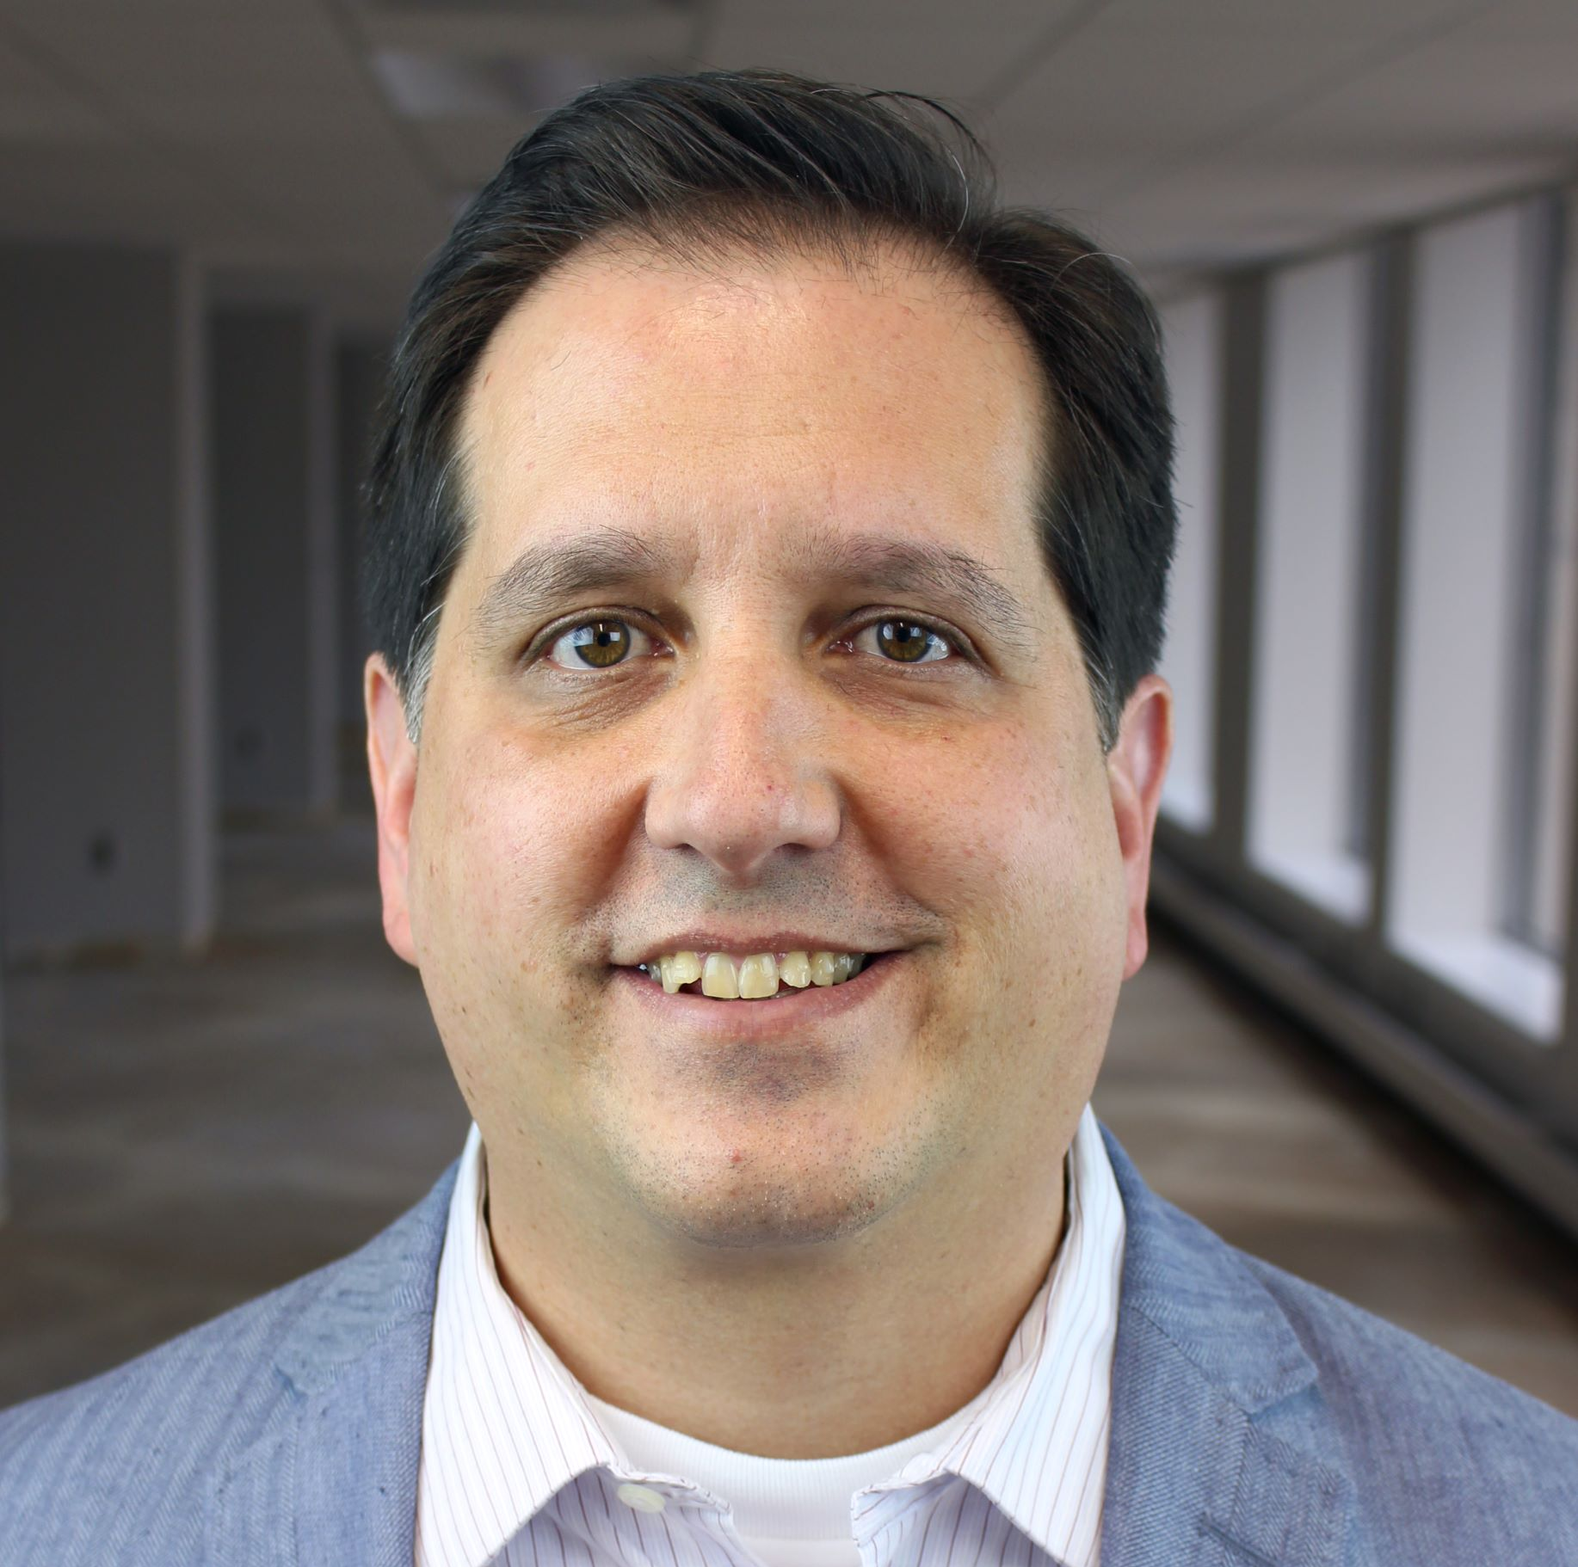




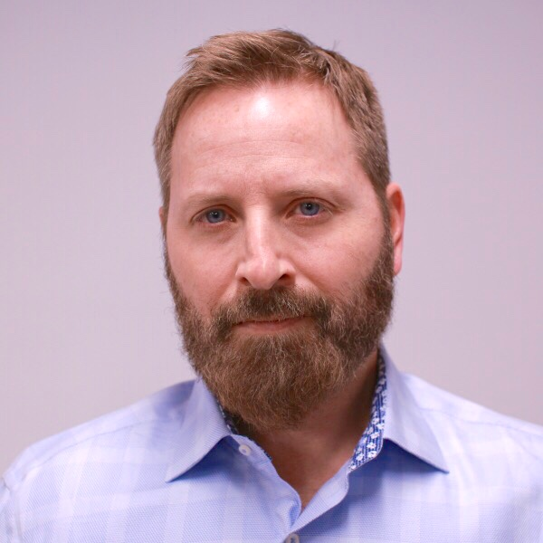




DevOps CAT team mission
Work with Microsoft’s largest customers to help them accelerate their DevOps transformation.

Slide 3
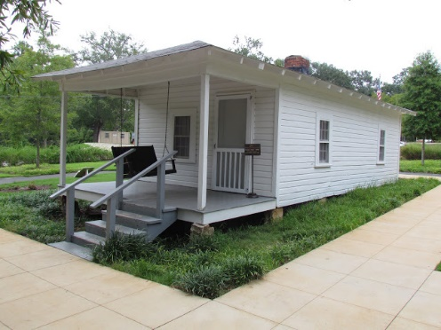

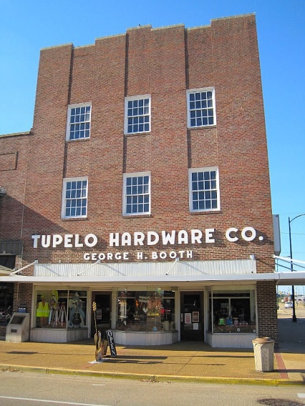
What is Tupelo, MS world-famous for?

Slide 4
Accelerating Delivery with DevOps
Develop
“
DevOps is the union of people, process, and products to enable continuous delivery of value to your end users.
”
DevOps
Operate
Deliver
Notes:
DevOps allows us to accelerate delivery, while still delivering reliable products and services
This is about bringing people together, through shared common goals, increased collaboration and a focus on improvement
Technology plays a key role in helping to execute a DevOps strategy by enabling teams to collaborate more, enhance productivity, facilitate experimentation and automate their processes from development, through to delivery and operations
It’s also about delivering value faster by increasing efficiency, eliminating waste and streamlining feedback back to developers to continuously improve the product
The result: better products, delivered faster, to happier customers
https://medium.com/@DonovanBrown_41367/dissecting-the-definition-69151da0435f

Slide 5





I work on Azure DevOps
Continuous Delivery for Every Team, Every App, Every Platform
Azure Boards
Azure Pipelines
Azure Repos
Deliver value to your users faster using proven agile tools to plan, track, and discuss work across your teams.
Build, test, and deploy with CI/CD that works with any language, platform, and cloud. Connect to GitHub or any other Git provider and deploy continuously.
Get unlimited, cloud-hosted private Git repos and collaborate to build better code with pull requests and advanced file management.
Azure Test Plans
Azure Artifacts
➔
Test and ship with confidence using manual and exploratory testing tools.
Create, host, and share packages with your team, and add artifacts to your CI/CD pipelines with a single click.
https://azure.com/devops
Notes:
So does TFS

Slide 6
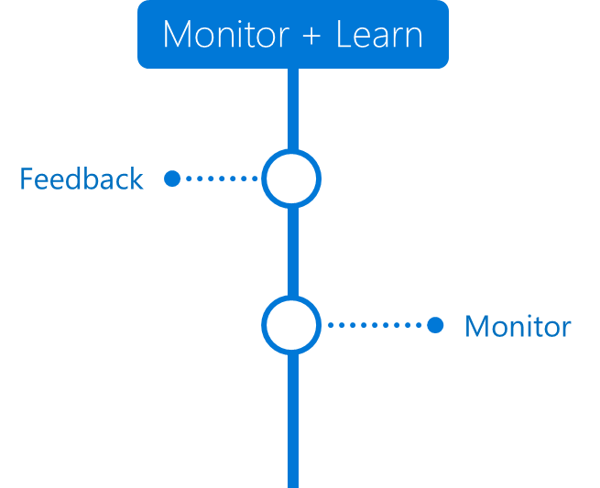

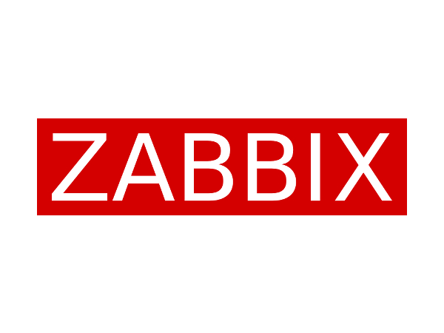



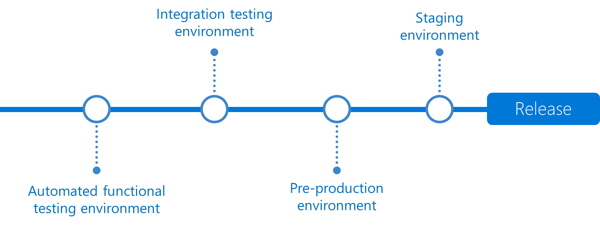
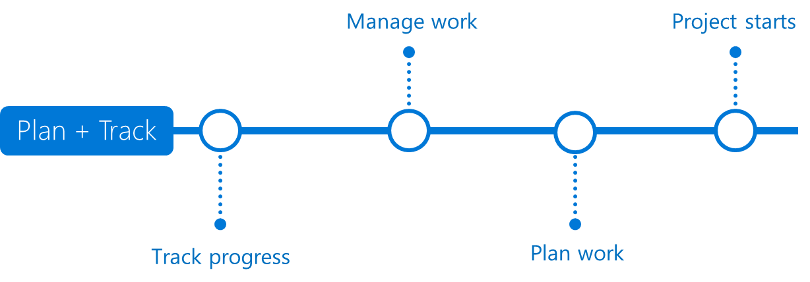



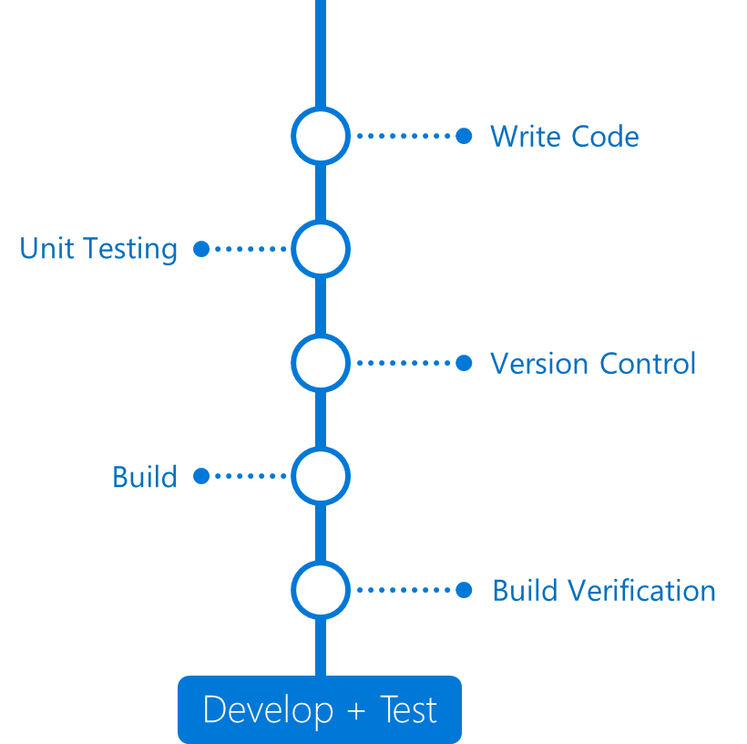
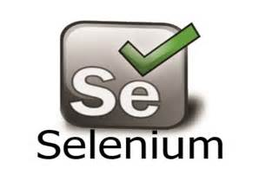

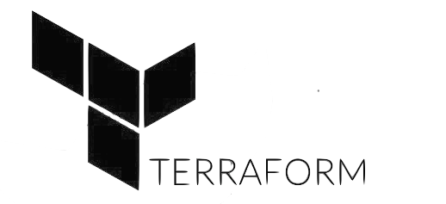












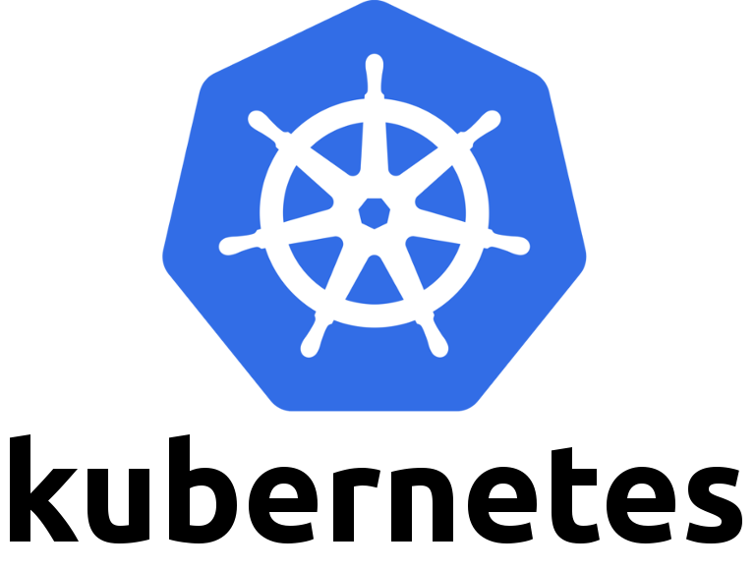





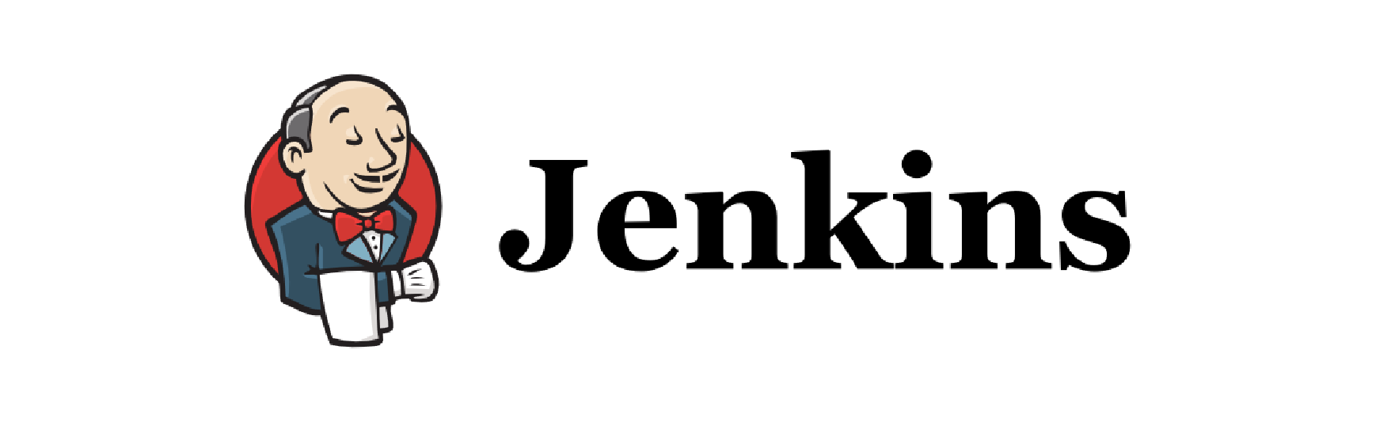




Azure DevOps
Application Insights
Any language, Any Platform
DevOps
DevOps
Visual Studio

Slide 7
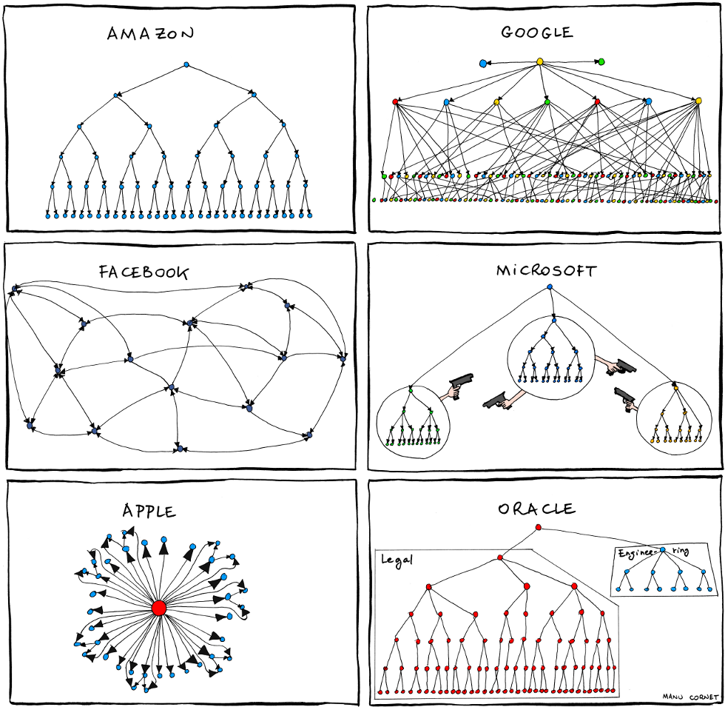
http://www.bonkersworld.net/images/2011.06.27_organizational_charts.png
Notes:
Manu Cornet, works at Google. Org Charts from back in 2011

Slide 8
http://www.bonkersworld.net/images/2011.06.27_organizational_charts.png
Notes:
Manu Cornet, works at Google

Slide 9

One Engineering System using Azure DevOps
There cannot be a more important thing for an engineer, for a product team, than to work on the systems that drive our productivity.
So I would, any day of the week, trade off features for our own productivity.
I want our best engineers to work on our engineering systems, so that we can later on come back and build all of the new concepts we want.
- Satya Nadella

Slide 10
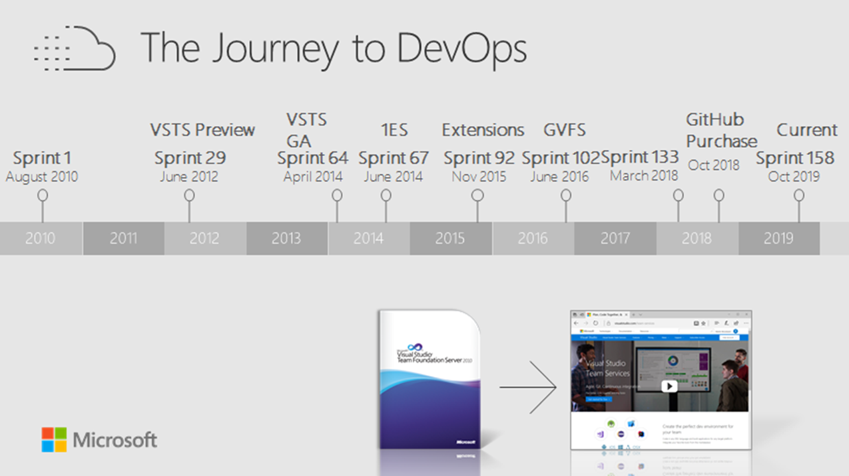

Slide 11
DevOps inside Microsoft
➔
https://aka.ms/DevOpsAtMicrosoft
110k
Active users inside Microsoft
4.6m
Builds per month
28k
Work items created per day
82,000
Deployments per day
2.4m
Private Git commits per month
8.8k Open Source repos on GitHub
25k
Employees contributing to open source
Data: Internal Microsoft engineering system activity, Sept 2019

Slide 12
Five habits we’ve learned so far
Customer Obsessed
Production First Mindset
Team Autonomy + Enterprise Alignment
Shift Left Quality
Safe Deployments and Limiting Damage
Notes:
We’re a long way on the journey, and still have a lot to learn. But here are 5 habbits that we’ve learned so far.
Customer Obsessed, Team Autonomy and Shifting Left are basically second decade agile
DevOps brings Product First Mindset and Infrastructure as a Flexible Resource into play
Note that they all result in some inter-related processes. We’ve got to where we are now over a long time, and it’s been a very iterative process.
But we’re not done – we’ve still lots to learn.

Slide 13
Five habits we’ve learned so far
Customer Obsessed
Production First Mindset
Team Autonomy + Enterprise Alignment
Shift Left Quality
Safe Deployments and Limiting Damage
Notes:
But first let’s talk about what I mean by being Customer Obsessed. That starts by our very definition of what DevOps is…

Slide 14
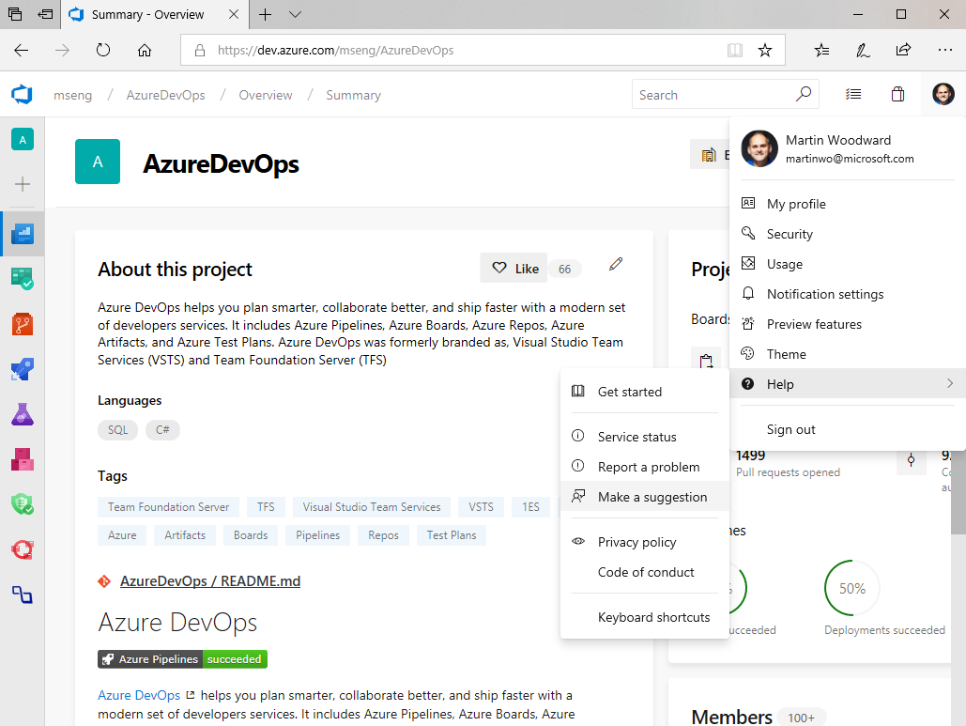
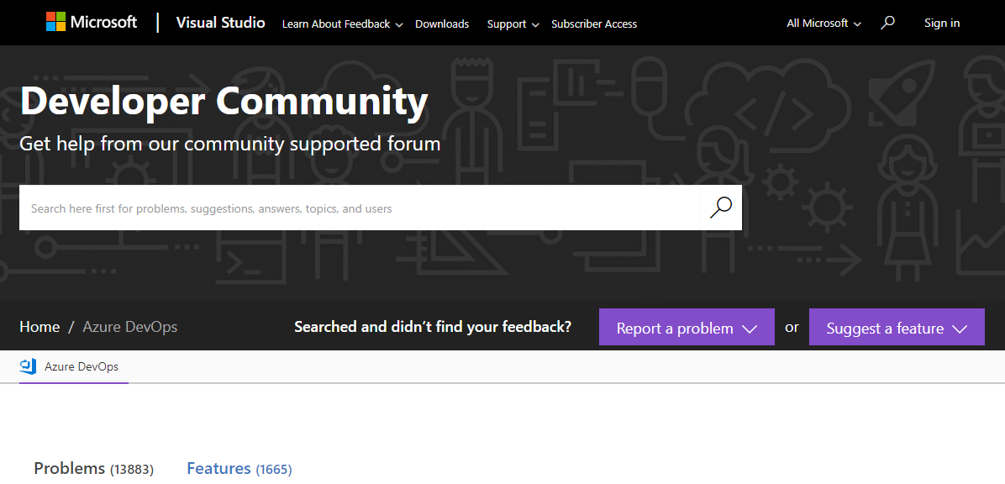
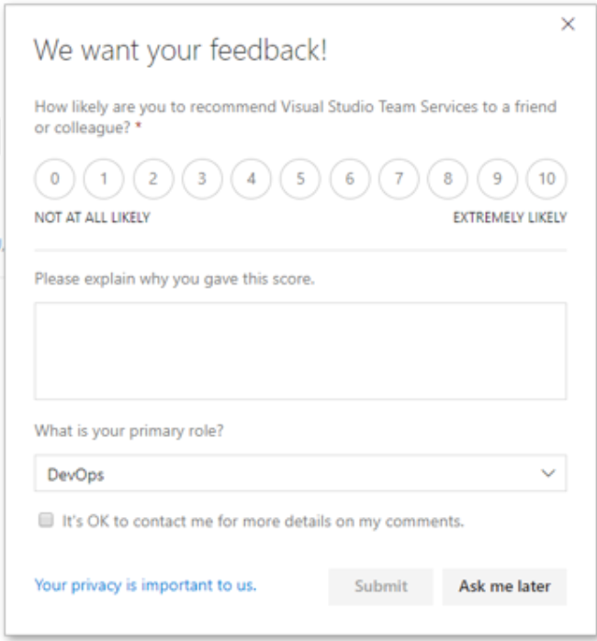
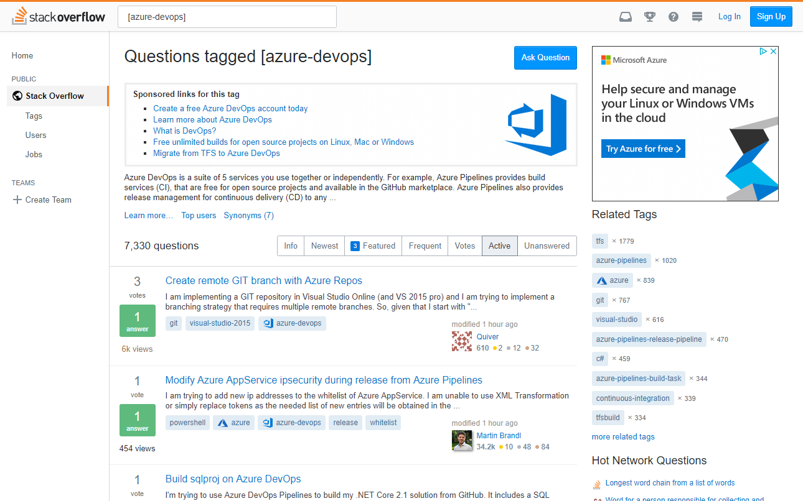
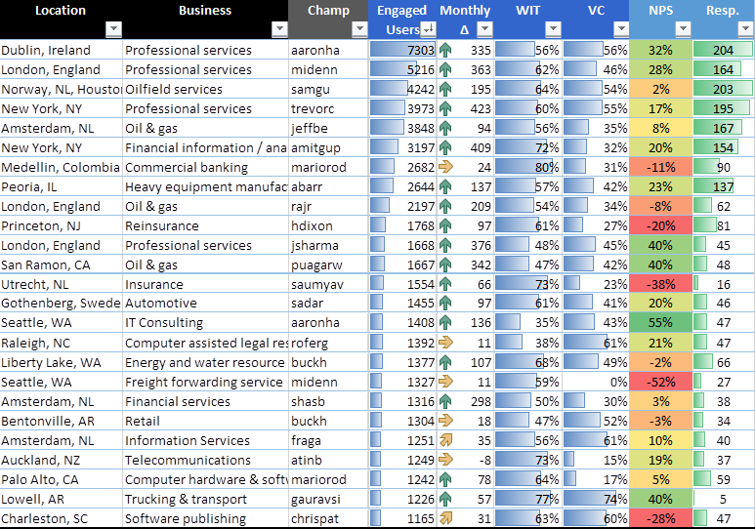
Listen to our customers
Quantitively & Qualitatively

Slide 15
Our Definition of Done
Live in production,
collecting telemetry
that examines the hypothesis which motivated the deployment.

Slide 16
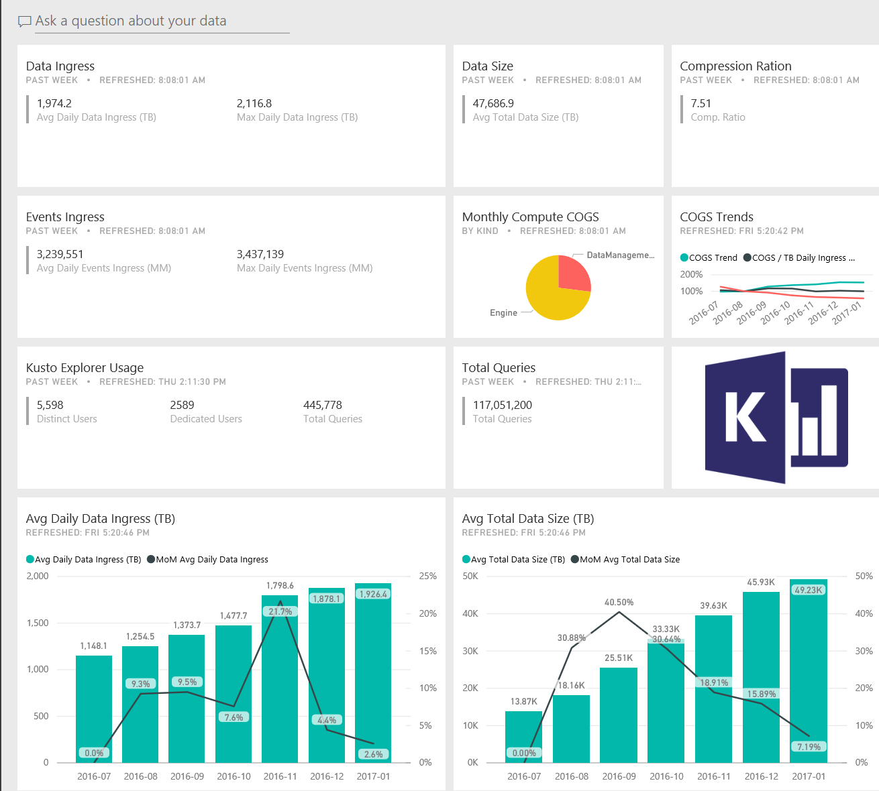
Collect data broadly (but carefully)
Application Insights Analytics (Project Kusto) for
text search and queries over structured and semi-structured data
high volume ingestion
fast queries over very large data sets

Slide 17
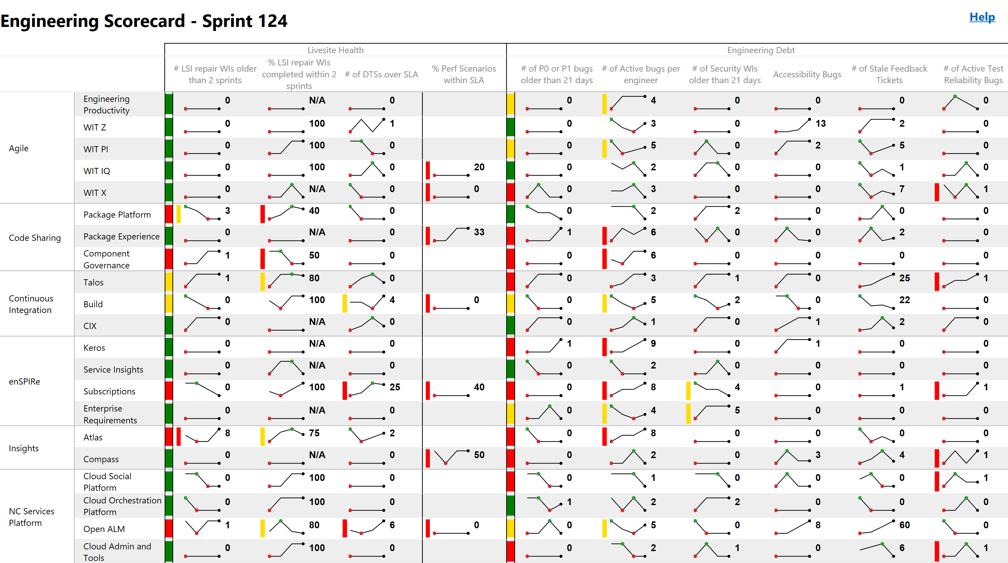
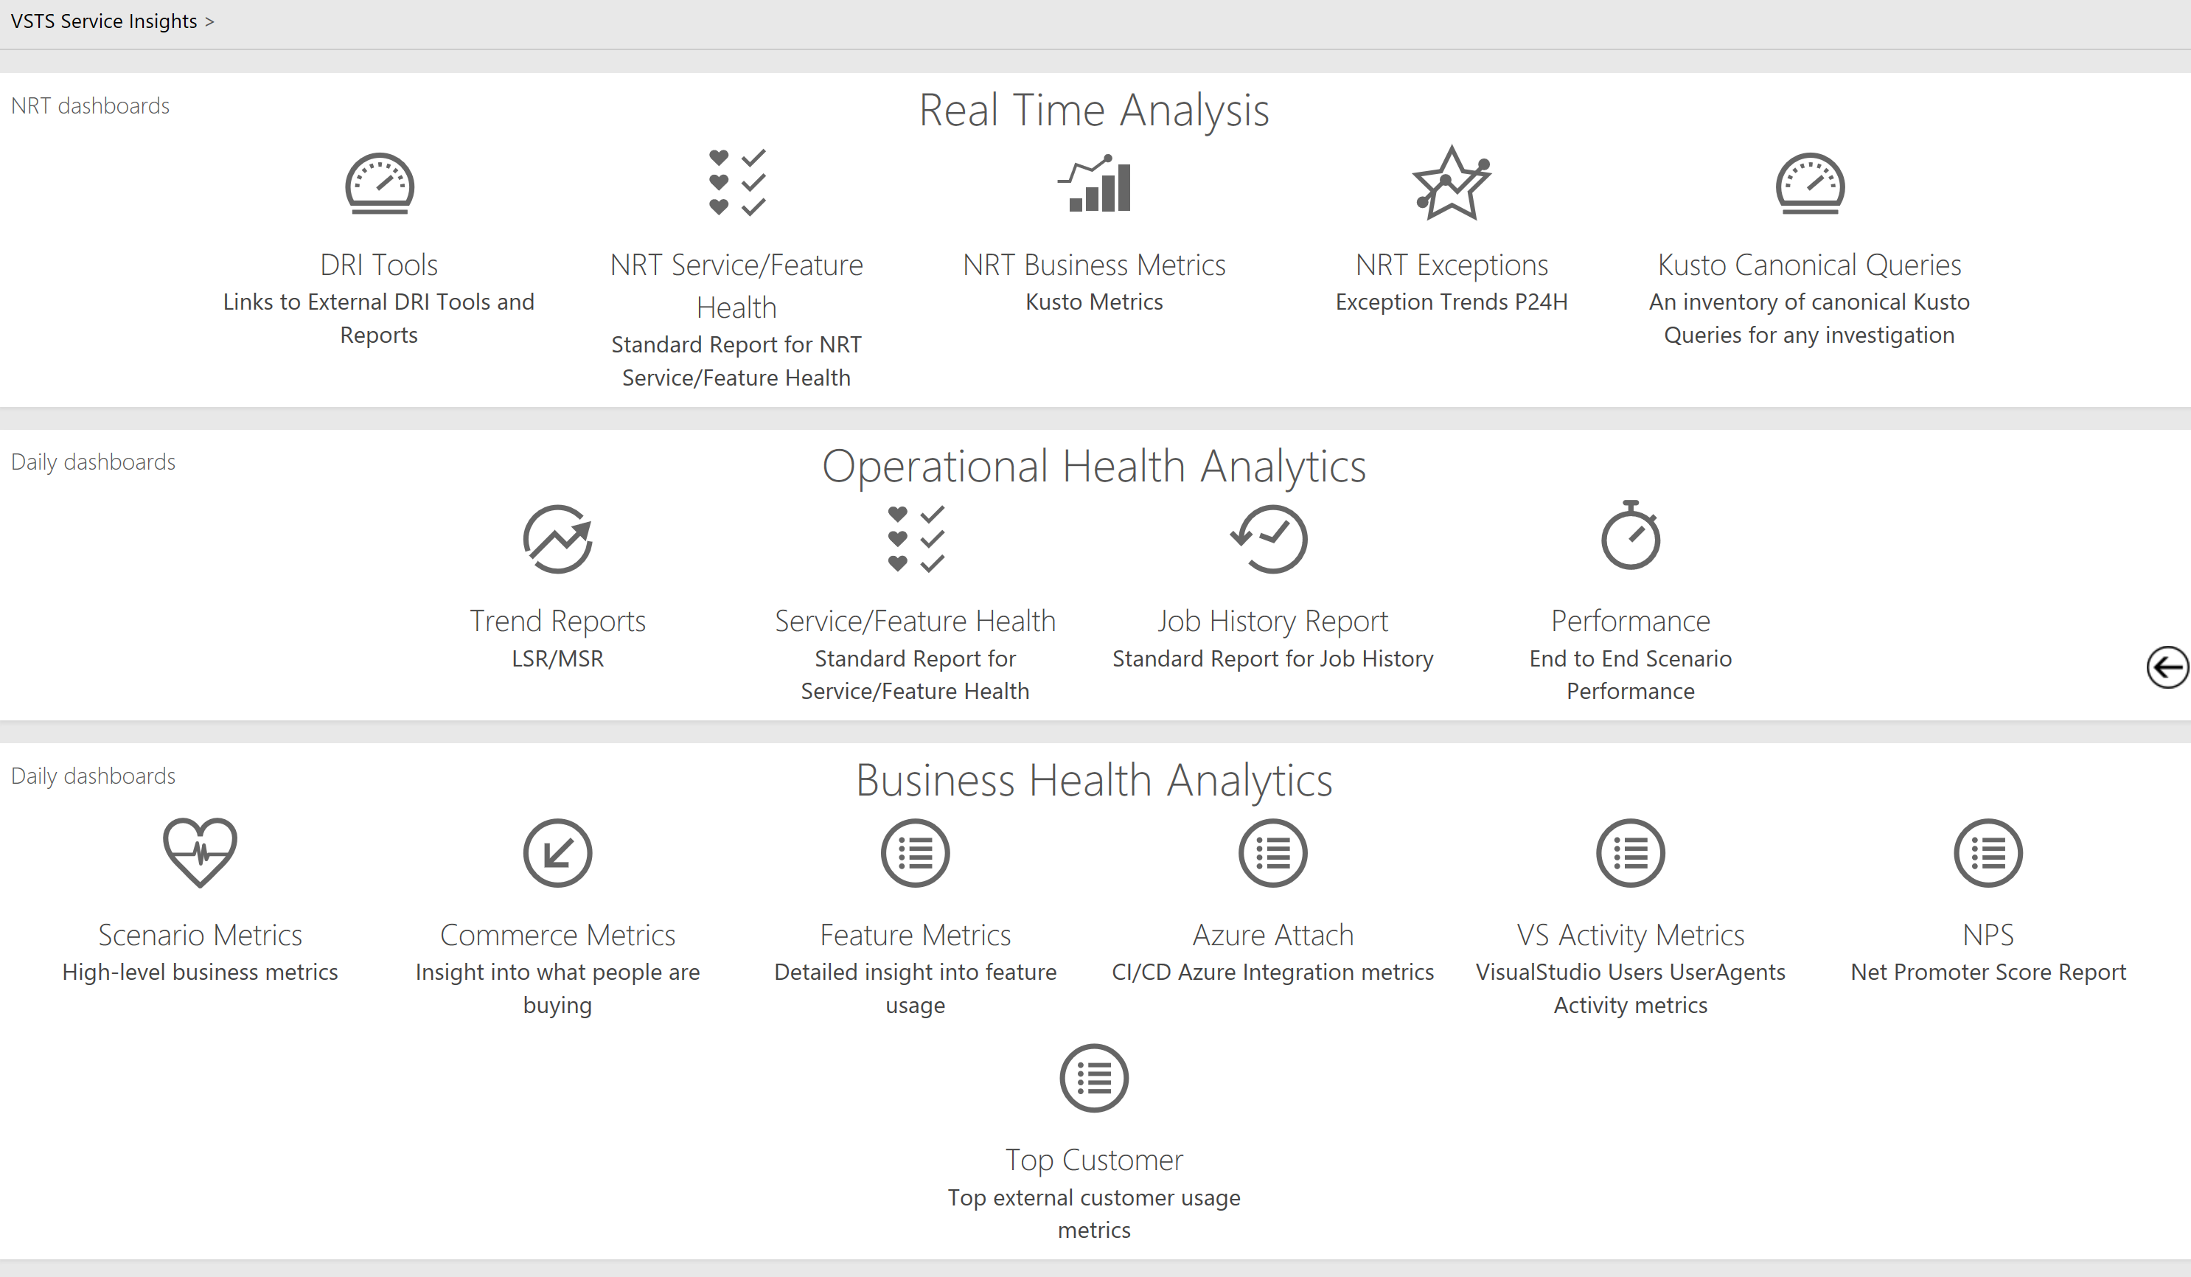
You get what you measure (Don’t measure what you don’t want)
Customer Usage
Acquisition
Retention
Engagement
Satisfaction (NPS)
Feature Usage
Live Site Health
Things we don’t watch
Time to Detect
Time to Communicate
Time to Mitigate
Which customers affected
Incident Prevention Items
Aging Prevention Items
SLA per Customer
Customer Support Metrics
Original estimate
Completed hours
Lines of Code
Team capacity
Team burndown
Team story point velocity
# of bugs found
% code coverage
Pipeline Velocity
Time to Build
Time to Test
Time to Deploy
Time to Improve
Failed and flaky automation

Slide 18

Build-Measure-Learn
Hypothesis
We believe {customer segment} wants {product/feature} because {value prop}
Experiment
To prove or disprove the above, the team will conduct the following experiment(s): …
Learning
The above experiment(s) proved or disproved the hypothesis by impacting the following metric(s): …

Slide 19
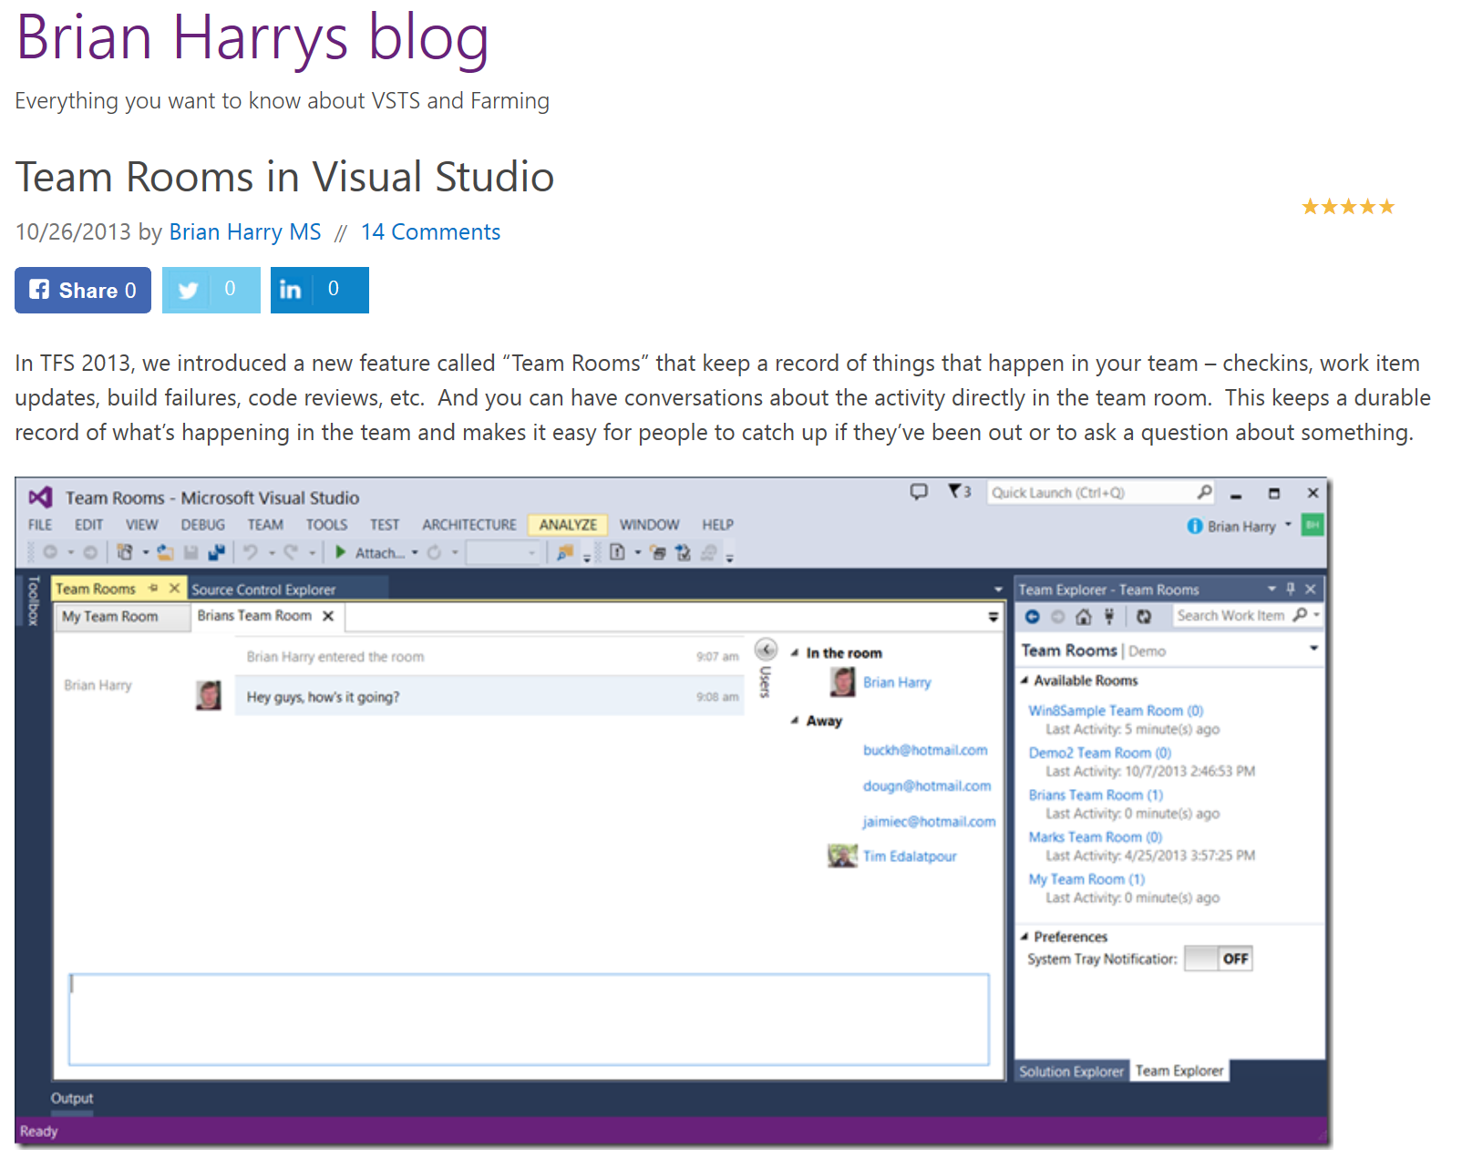
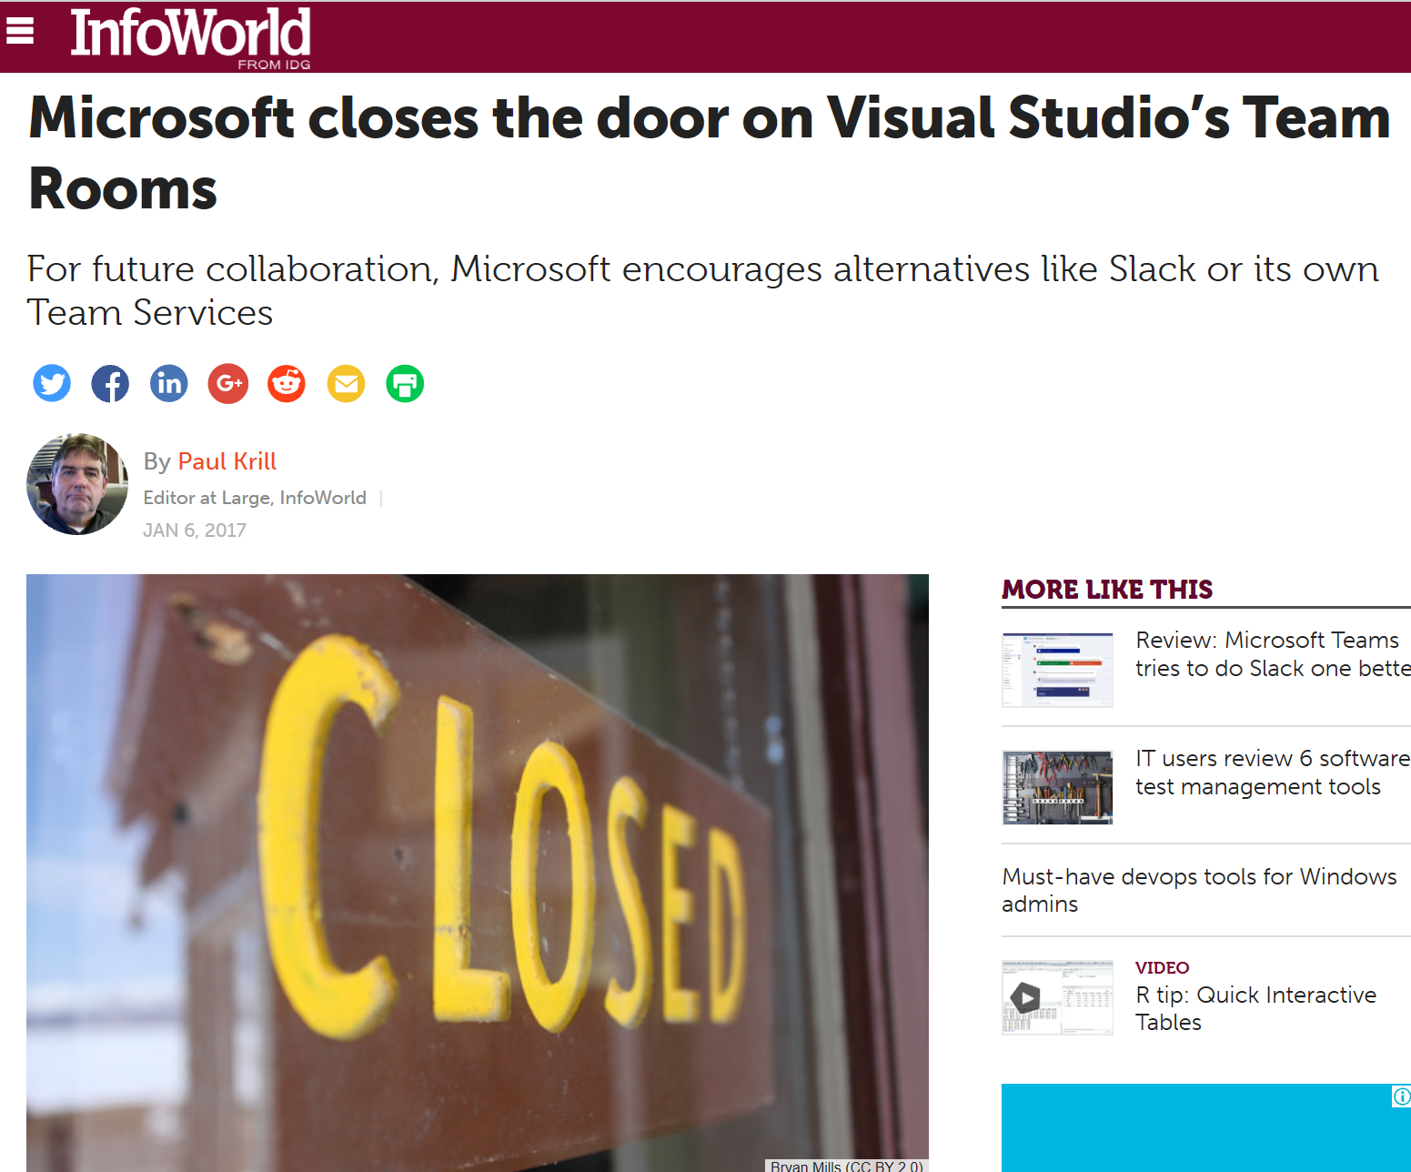
Failure is an opportunity to learn
Notes:
Listening to our customers is important. Sometimes that doesn’t have the results we hoped. For example we heard from our customers that we needed enterprise-social features built into the product. We evaluated the hypothesis, designed the experience (Team Rooms) and then learnt (over time) that our customers looked at it but then rarely ever used it. After investigating why usage was well below expectations, we eventually removed the feature from the product allowing us to focus our efforts in other areas.

Slide 20
Five habits we’ve learned so far
Customer Obsessed
Production First Mindset
Team Autonomy + Enterprise Alignment
Shift Left Quality
Safe Deployments and Limiting Damage

Slide 21
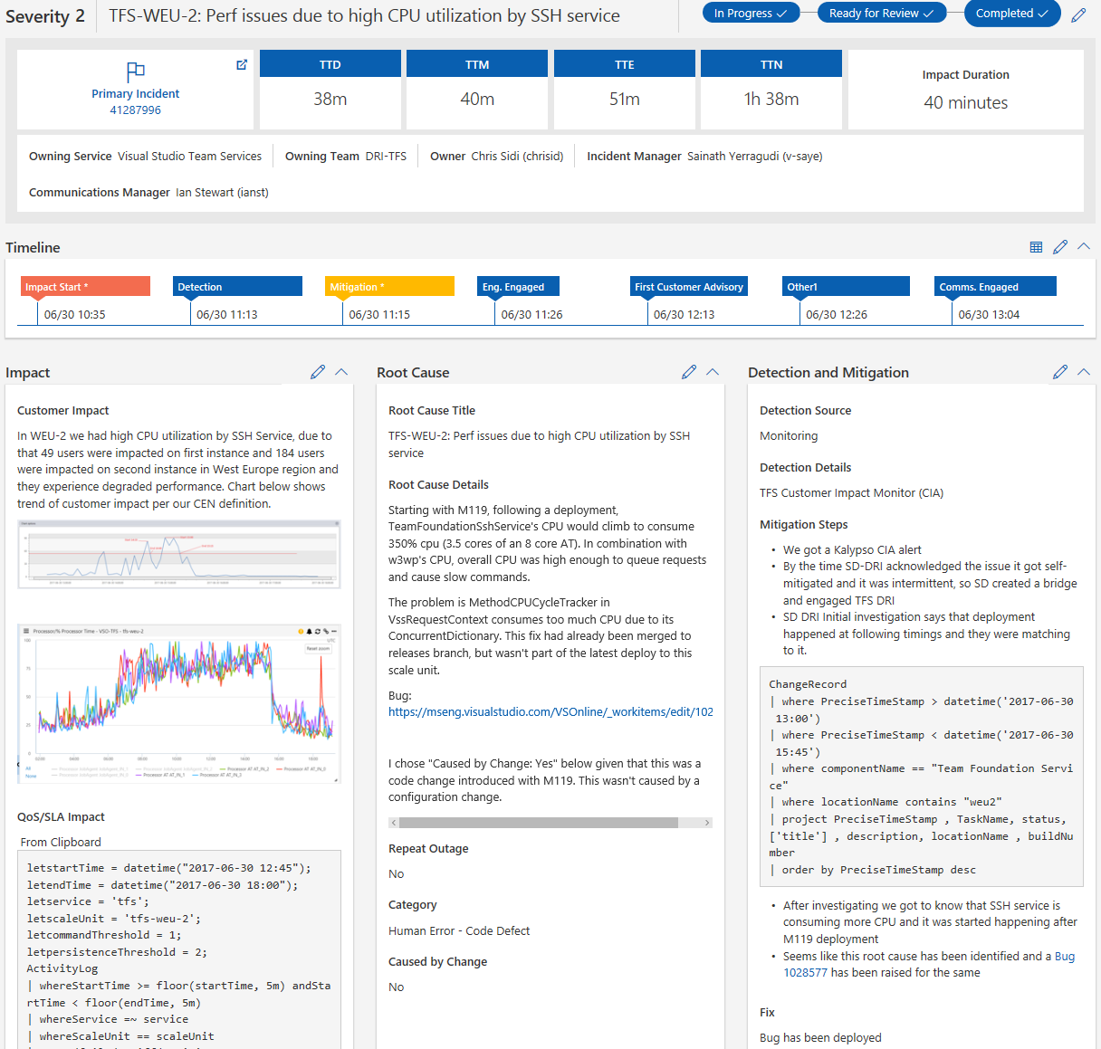
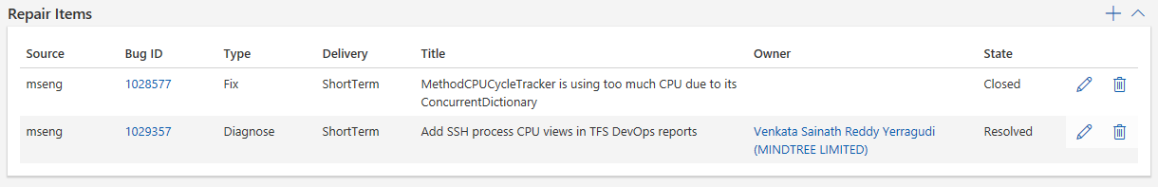
Live Site Incidents
On detection, LSI conference bridge created
DRI’s brought in to call
Communication externally and internally
Gather data for repair items & mitigate for customers
Every action recorded
Plan to rotate people during long running LSI’s
Create & track repair Items to prevent reoccurrence and improve detection time

Slide 22
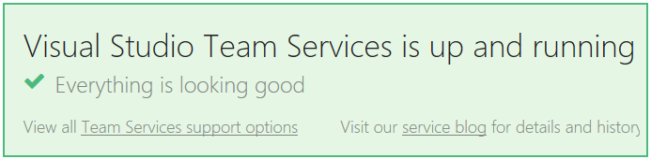
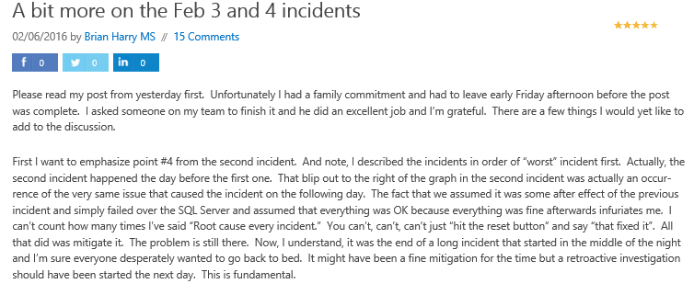
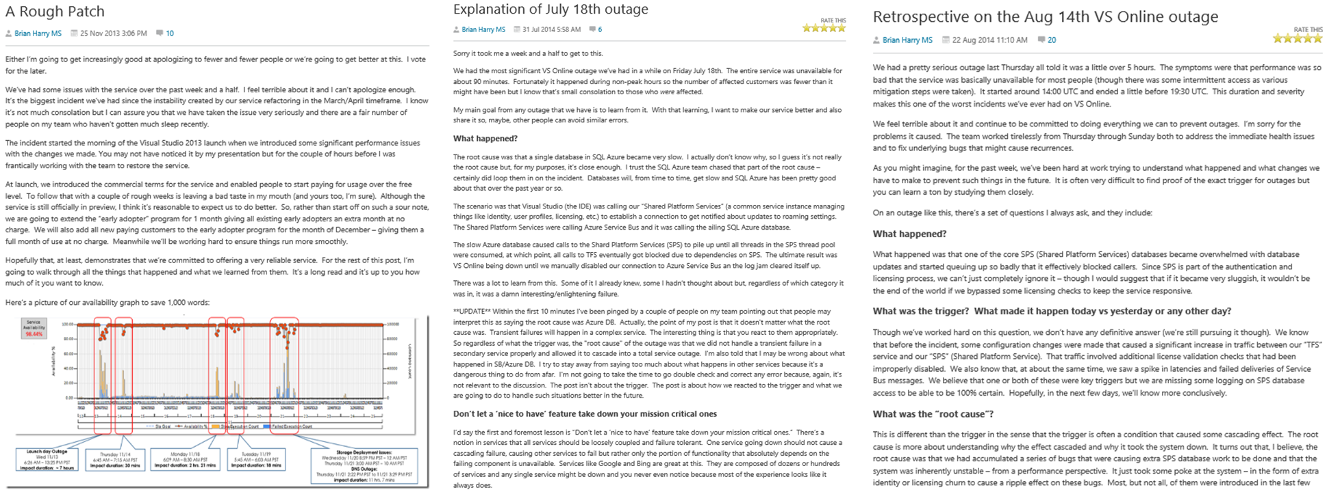
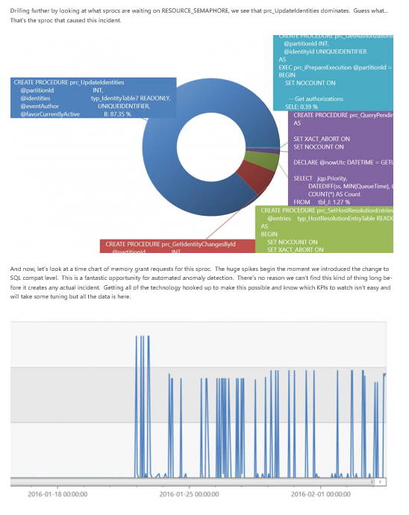
Be Transparent

Slide 23
No such thing as ‘partial automation’
“One time” deployment commands in OneNote, email
Set-Options “-p 0”
Imagine a dozen more steps like that…
And then…someone misses a step half way through
We once broke pre-production for a day

Slide 24
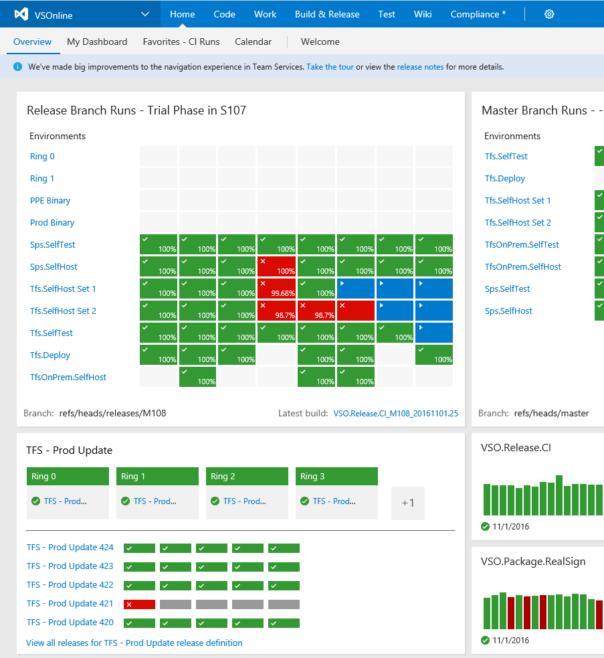
Automate completely
No more “one time” commands run manually
Every command goes in PowerShell scripts that are checked in
Deployment to pre-production & canary is the same as deployment to production every time
All orchestrated with Azure Pipelines

Slide 25
Security Mindset - Assume Breach
Started with war games to the learn attacks and practice response
vs.
Initially double-blind test
Over time, eliminated blue team
Our defenders need to be our defenders
Shifted left to prevent top risks
Credential theft
Secret leakage
OSS vulnerabilities
Notes:
Red Teaming
Shift-Left Security
Threat Modeling
Production Hardening – Azure Security Center, Secrets Management, JIT Admin, DRI Laptops

Slide 26
Five habits we’ve learned so far
Customer Obsessed
Production First Mindset
Team Autonomy + Enterprise Alignment
Shift Left Quality
Safe Deployments and Limiting Damage

Slide 27

Agile at Scale with Aligned Autonomy
“Let’s try to give our teams three things…. Autonomy, Mastery, Purpose”
Organization
Roles
Teams
Cadence
Taxonomy
Plan
Practices
Alignment
Autonomy

Slide 28
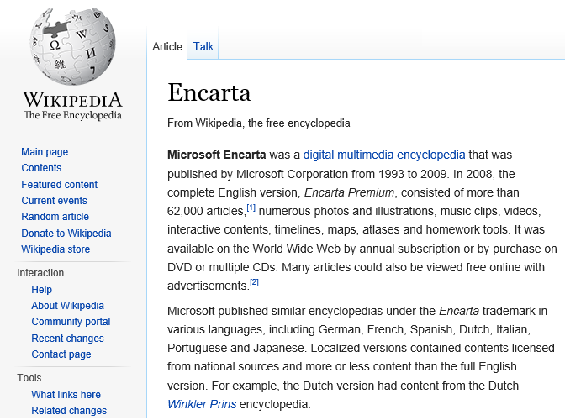


Group A
Business plan
Established in the market
Well funded
Hiring the best people
Group B
Working for free
In their spare time
Because they want to

Slide 29

Team Structure
Introduced Combined Engineering in December 2014

Slide 30
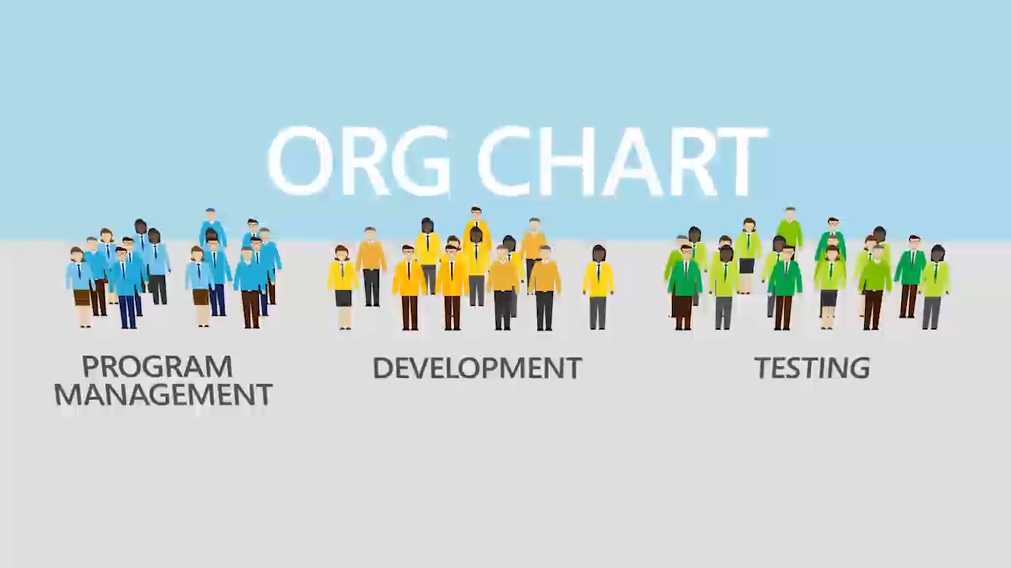

Slide 31
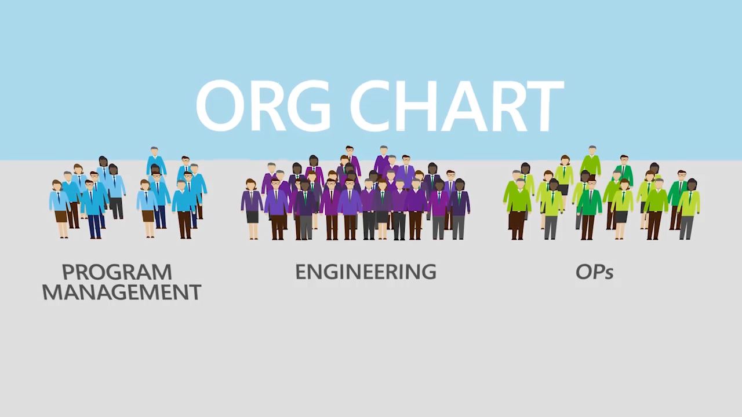

Slide 32
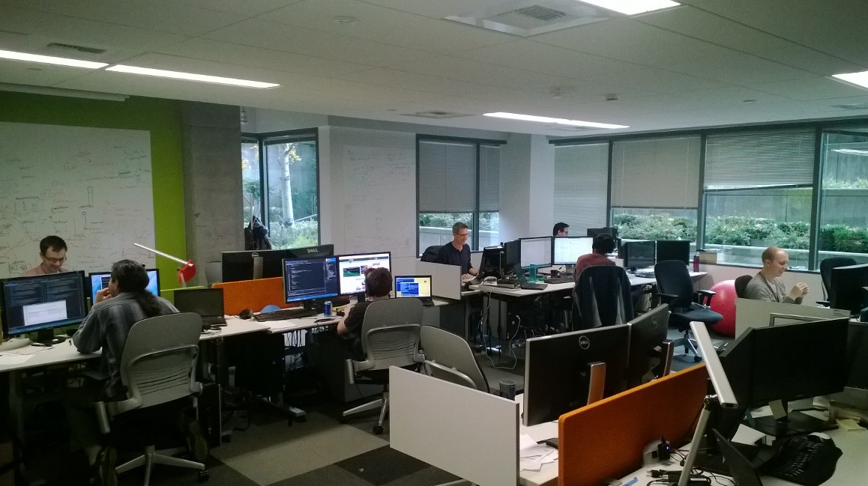
Teams
Physical team rooms
Cross discipline
10-12 people
Self managing
Clear charter and goals
Intact for 12-18 months
Own features in production
Own deployment of features

Slide 33
Instead of Horizontal…
UI
API
Data

Slide 34
We strive for Vertical
UI
API
Data
Notes:
Autonomy, accountability, and fewer dependencies
Not every team works like this. At least 2 layers are owned by a team to align requirements and priorities. Still need enough critcal mass so they become area and tech experts.

Slide 35
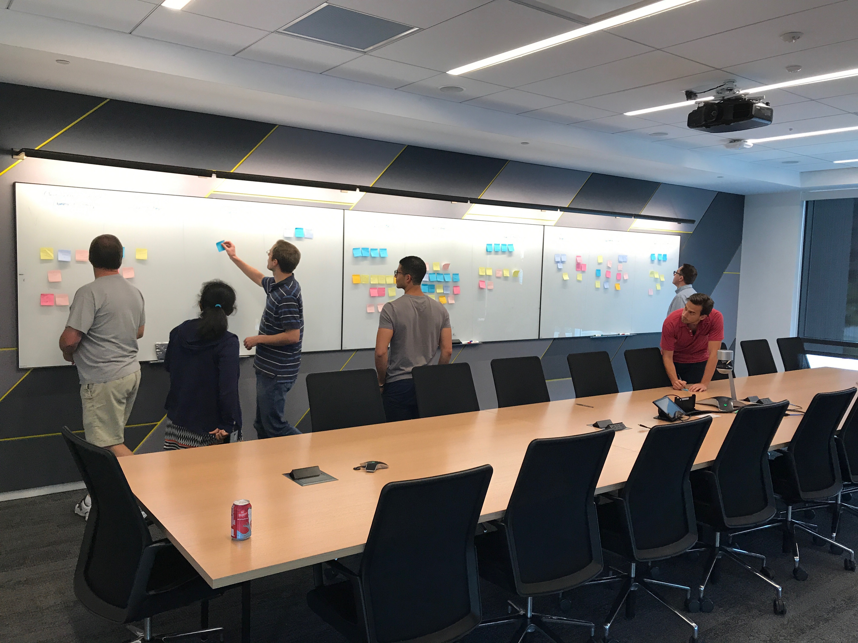
Sticky Note Exercise - Self Forming Teams
Opportunity to change team without formal interviews or top down re-org
Unique approach within Microsoft
Create opportunities for everyone to learn new things
Typically <20% change, but 100% get to make a choice
Employee choice, not manager driven
Cross-pollinate talent and micro-culture

Slide 36
Planning
Leadership is responsible for the big picture
Sprint
3 weeks
Quarter
4 sprints
Semester
6 months
Strategy
12 months
1
4
6
12
Teams are responsible for the detail

Slide 37
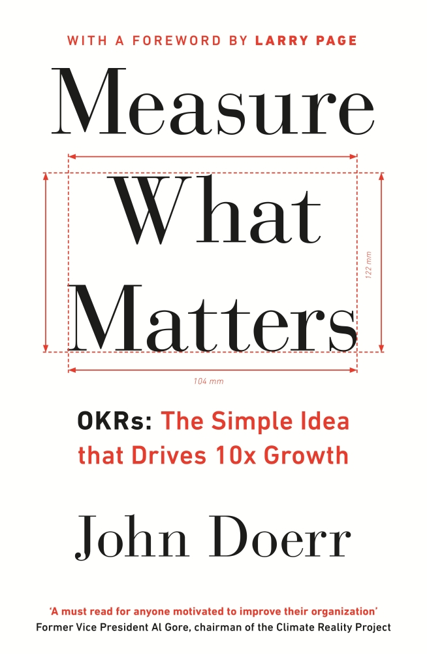
Measure Outcomes not Outputs
OKR: Objective→Key Results
1. Objective: Grow a strong and happy customer base
1.1 Increase external NPS from 21 to 35
1.2 Increase docs SAT from 55 to 65
1.3 New pipeline flow has an Apdex score of 0.9
1.4 Queue time for jobs is 5 seconds or less
KRs are measures for the quarter
Encourage ambitious KRs: 70% of the improvement target scores green

Slide 38
Alignment
Product OKRs
Service OKRs
Service OKRs
Service OKRs
Service OKRs
Service OKRs
Team OKRs
Team OKRs
Team OKRs
Team OKRs
Team OKRs
Team OKRs
Team OKRs
Team OKRs
Team OKRs
Team OKRs
Team OKRs
Team OKRs

Slide 39

How do you stay in sync?
Sprint mail
As needed: Experience Reviews
OKR check 2 sprints
OKR reset 4 sprints
Notes:
We’re going to stop doing all this crazy schedule alignment. We have a single engineering schedule… period. Everyone will use the same language.

Slide 40
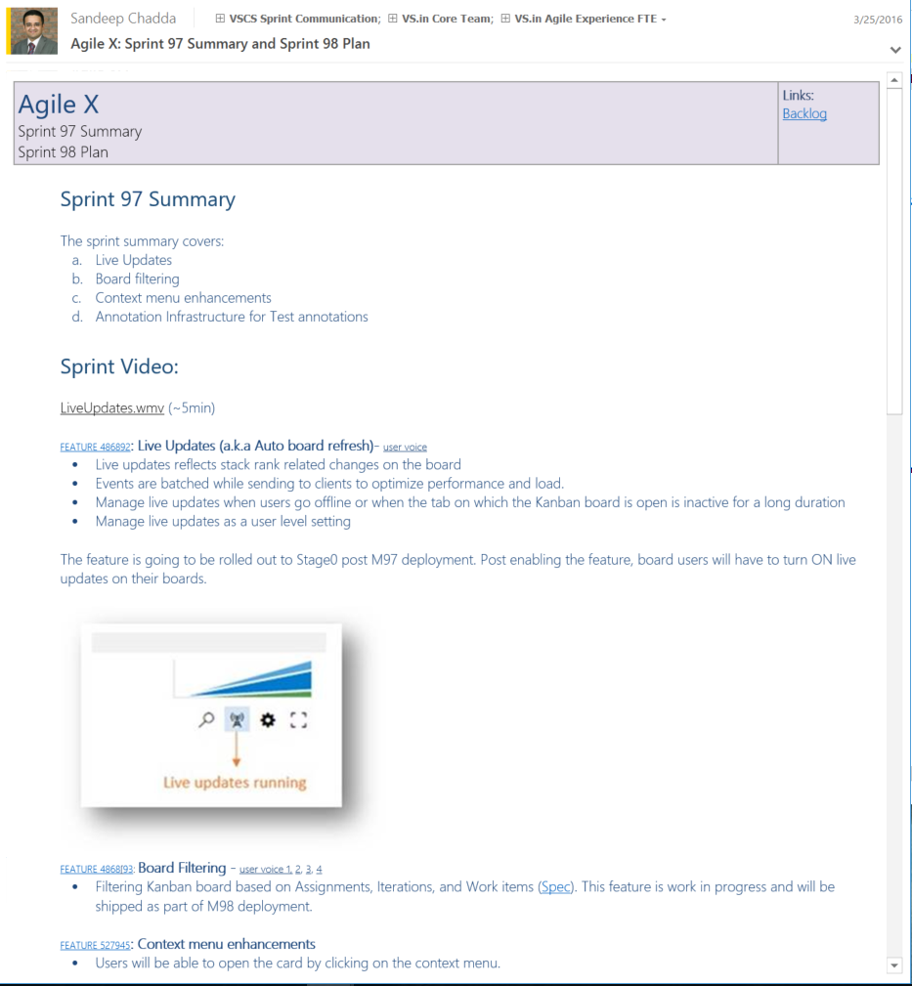
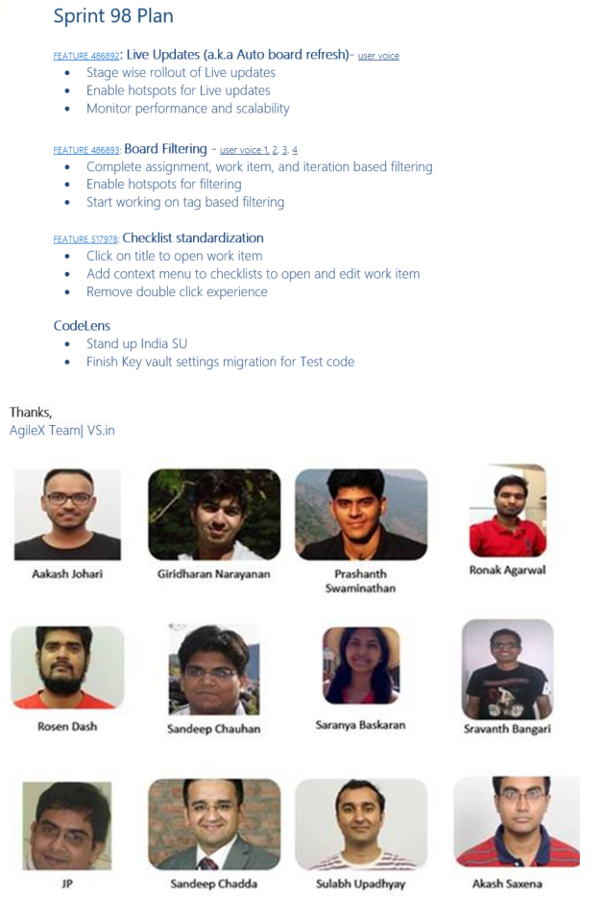
Sprint Mail – Per Crew (1st Six Years)
Value delivered during the sprint by each feature crew
Video demo of the value
What the feature team plans to accomplish in the next sprint
Opportunity to improve
Outputs not outcomes
Too granular for stakeholders
Too many to review well

Slide 41
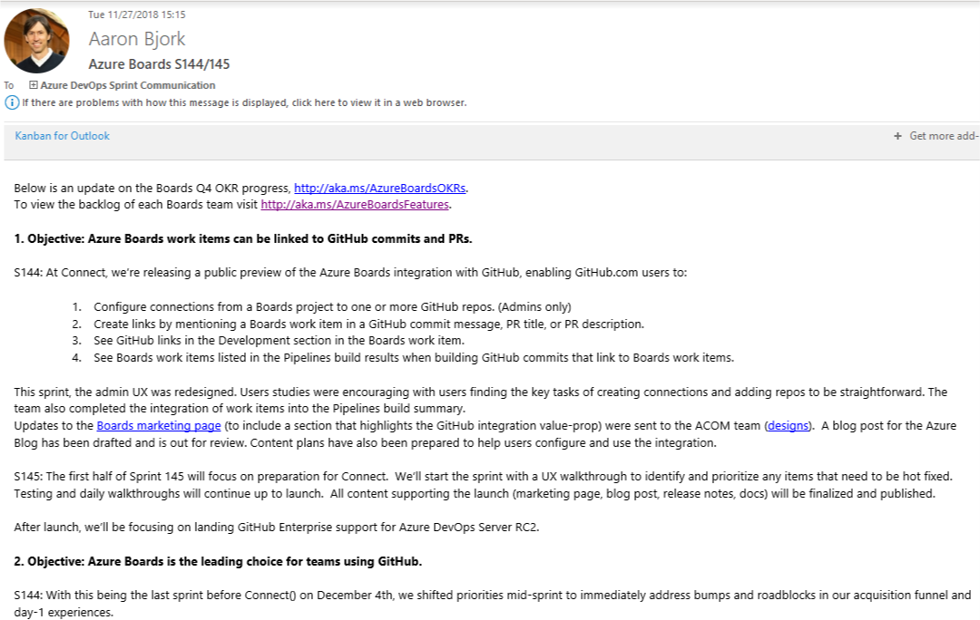
Sprint Mail – Per Epic (Current Practice)
Value delivered against each Objective for Epic
Video by Epic objective, not org structure
Value planned for Epic in next sprint

Slide 42
Five habits we’ve learned so far
Customer Obsessed
Production First Mindset
Team Autonomy + Enterprise Alignment
Shift Left Quality
Safe Deployments and Limiting Damage

Slide 43
Managing the pipeline:
How do you
go fast
and
not
break things?
Notes:
Combined engineering.

Slide 44
Do Not Incur Debt
We all follow a simple rule we call the “Bug Cap”:
#
engineers on your team
x
4
=
?
Notes:
1 bug per dev per day is the average over enough time. Started with 15 and the team just grew to that and stayed there. Limited to 5 so we were 5 – minimum - day from shipping. Maybe it’s more than that because of regressions. Zero Bug Bounce (ZBB)

Slide 45
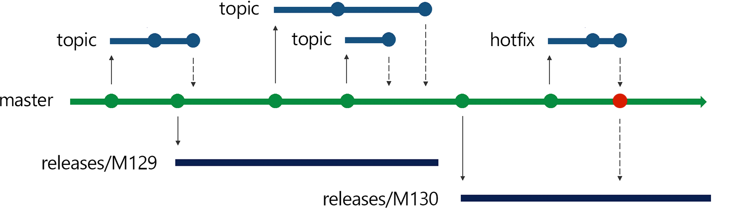
Release Flow
Using Trunk Based Development to avoid Merge Debt
Notes:
DevOps is the union of people, process and products to enable the continuous delivery of value to your end customers

Slide 46
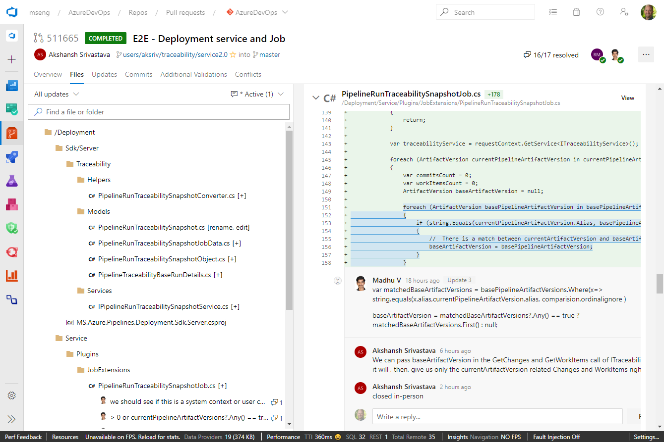
Pull requests
PR’s are point of code review
L0+L1 Tests performed before merge
Security tested before commit
Shift-left testing to pre-merge
1/5 Pull requests fail
Makes CI build failures rare
1/100 CI builds fail
Accelerates the inner and outer loops

Slide 47
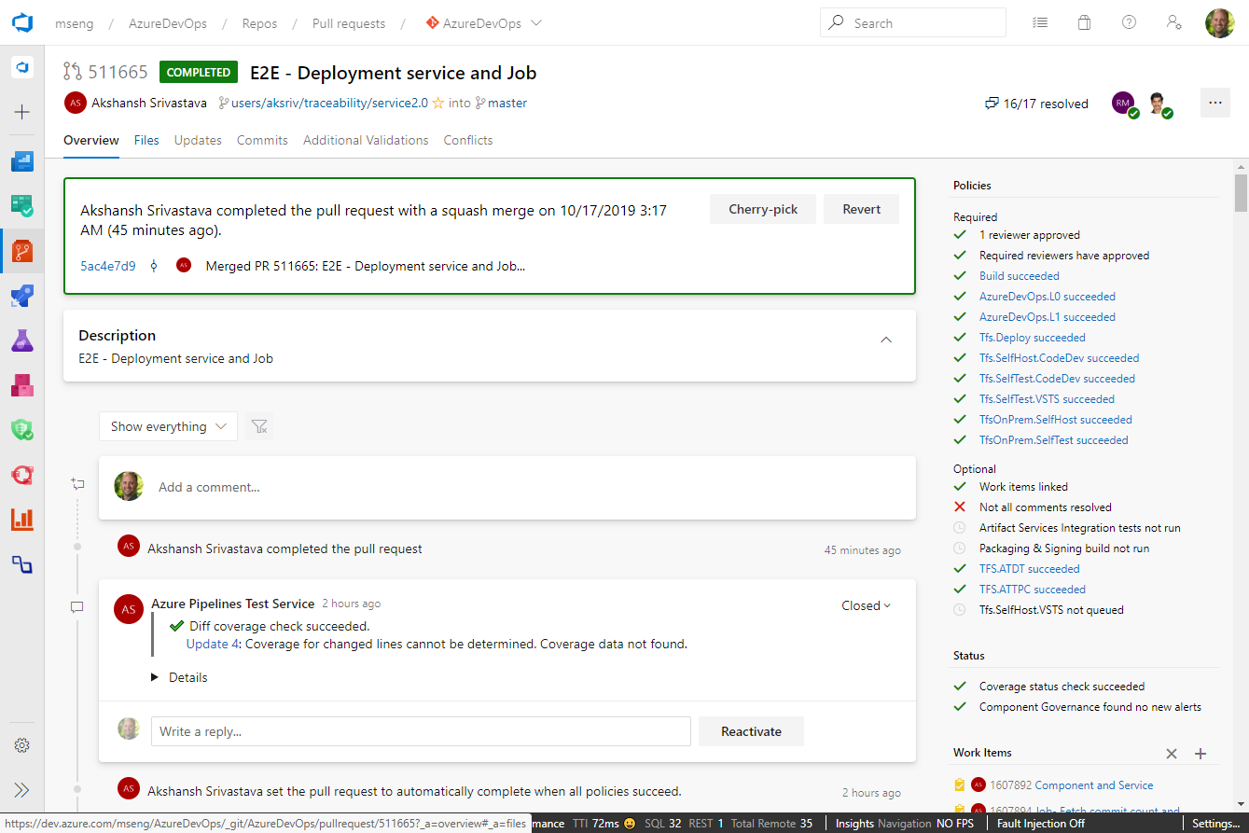
Pull requests
PR’s are point of code review
L0+L1 Tests performed before merge
Security tested before commit
Shift-left testing to pre-merge
1/5 Pull requests fail
Makes CI build failures rare
1/100 CI builds fail
Accelerates the inner and outer loops

Slide 48
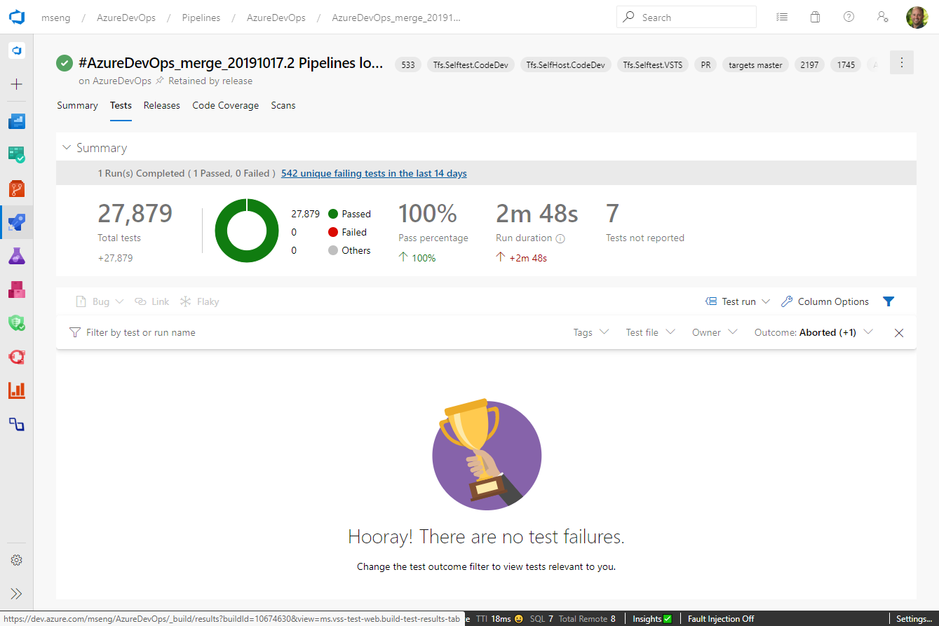
Tests against pull request
Feedback in minutes, before acceptance of PR

Slide 49
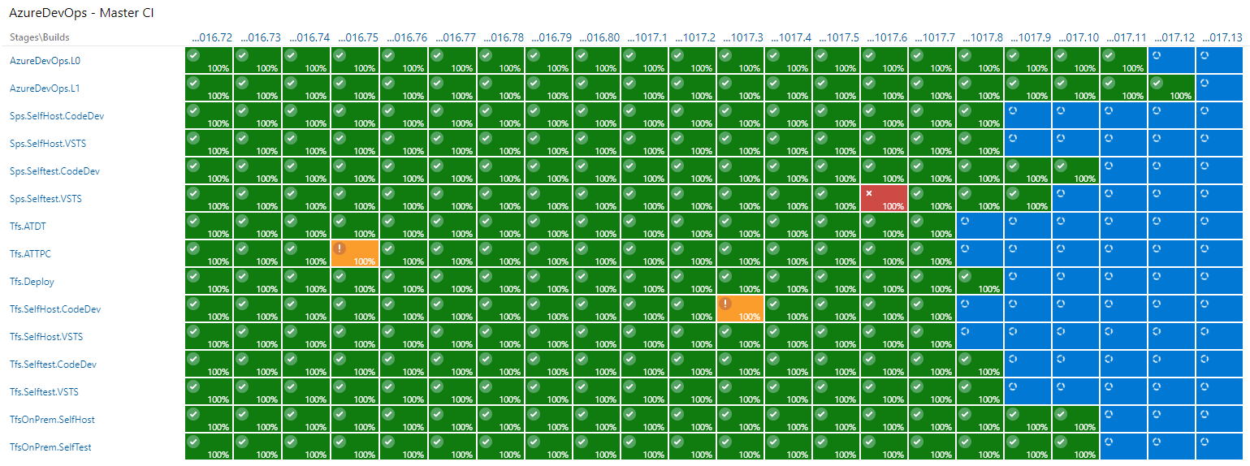
CI: Green Means Green, Red Means Red
Only all-green builds get to release

Slide 50
Created a “Non-Denominational” Test Taxonomy
In-memory unit tests with no dependencies
Unit tests with dependencies e.g. SQL
Functional tests against APIs
PROD
L0
L1
L2
L3
In Pull Request
< 60 ms
< 2000 ms (avg 400 ms)
In pre-prod deployment, with mocked auth
In production rings

Slide 51
Test portfolio over time

Slide 52
Test portfolio over time
TYPE | M78 | M144 | DELTA
L0 | 2723 | 77590 | + 74,867
L1 |  | 6906 | + 6,906
L2 |  | 6851 | + 6,851
TRA | 27054 | 0 | - 27,054

Slide 53
Five habits we’ve learned so far
Customer Obsessed
Production First Mindset
Team Autonomy + Enterprise Alignment
Shift Left Quality
Safe Deployments and Limiting Damage

Slide 54
Early Principles
The same tools we use to deploy to production we use in dev and test environments
The quality signals we look at to green light deployments are tracked constantly every day
Deployments take zero down time
Deployments happen during working hours
No ‘partial’ automation

Slide 55
What do feature flags give us?
Decouple deployment and exposure
Flags provide runtime control down to individual user
Change without redeployment
Controlled via PowerShell or web UI
Support early feedback, experimentation
Quick off switch

Slide 56
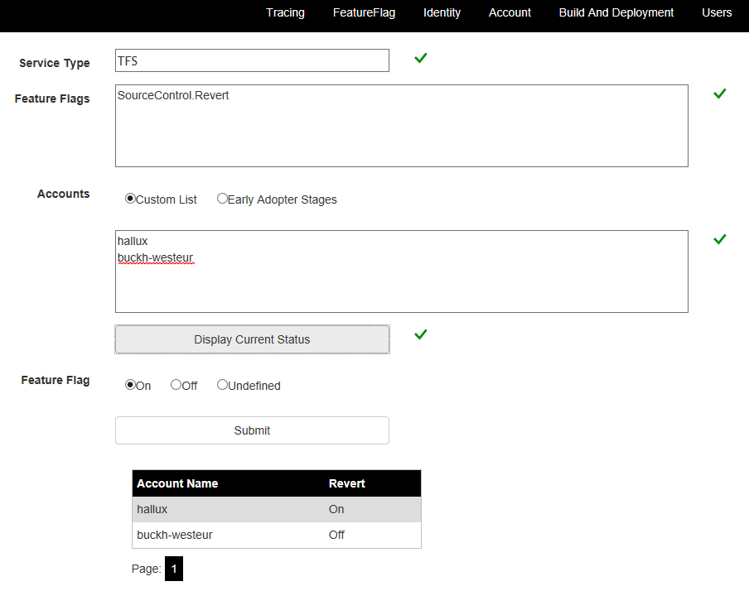
Control
PowerShell
Get-FeatureFlag
Set-FeatureFlag
Web UI

Slide 57
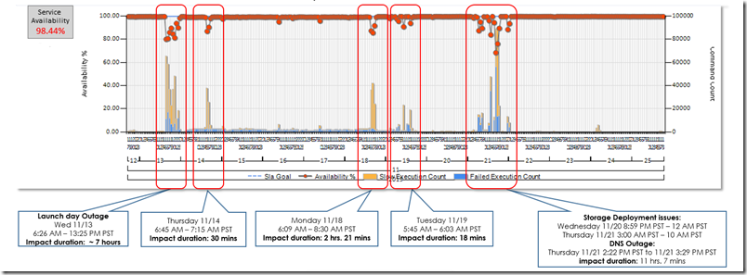
Awesome! What could go wrong?
Features to be revealed at big event
We turned features on globally just before the keynote...
It didn’t go well.

Slide 58
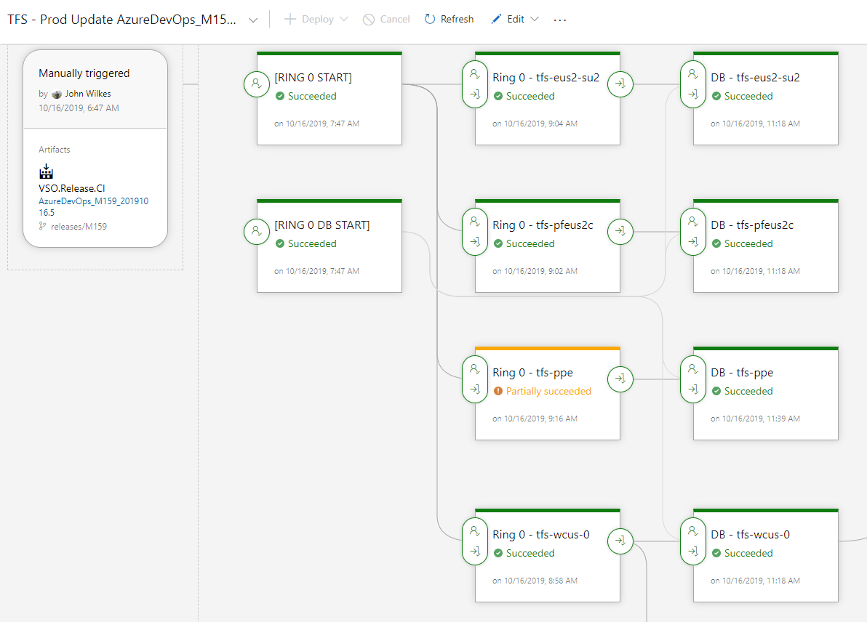
Progressive Exposure
Deploy one stage at a time
Release Gates control progression
Automated (L3) tests to check current ring
Can slow down with explicit approval
Visibility into impact of every deployment
Move across
Canary
Data centers with small user counts
Data center with large user count
Highest latency
The rest

Slide 59
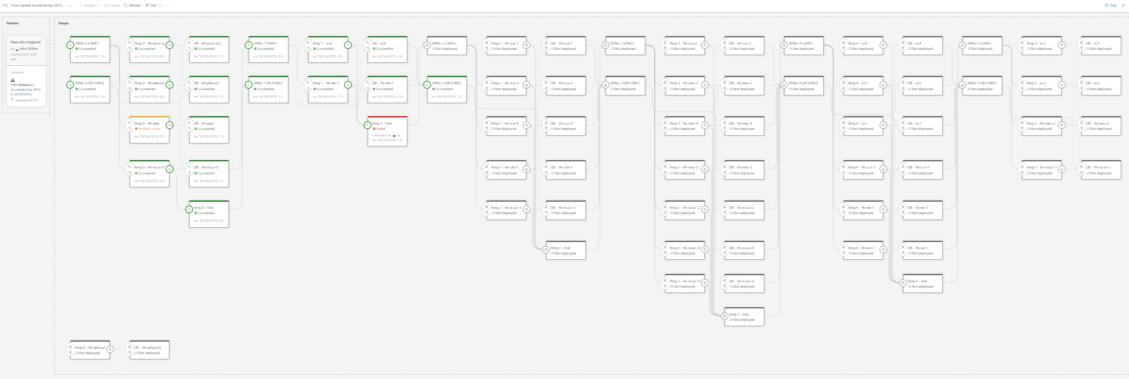
Progressive Exposure

Slide 60

Progress follows a J-curve

Slide 61
Our DevOps Transformation – the story so far
Before
4-6 month milestones
Horizontal teams
Personal offices
Long planning cycles
PM, Dev, Test
Yearly customer engagement
Feature branches
20+ person teams
Secret roadmap
Bug debt accumulated
100 page spec documents
Private repositories
Deep organizational hierarchy
Success is a measure of install numbers
Features shipped once a year
After
3-week sprints
Vertical teams
Team rooms
Continual Planning & Learning
PM & Engineering
Continual customer engagement
Everyone in master
8-12 person teams
Publicly shared roadmap
Debt paid as incurred
Mockups in PPT
Inner source
Flattened organization hierarchy
User satisfaction determines success
Features shipped every sprint

Slide 62

The journey has its ups and down,
but in the end it’s worth it

Slide 63
Features Delivered per Year
Our DevOps transformation has allowed our team to deliver more value to our customers at an increasing velocity.
Removing “taxes on the team” allowed us to ship more features in 2016 (262) than the previous 4 years combined (256 features).
364 features in 2017!
What happened in 2018?
GDPR compliance work (Global service)
Azure DevOps re-architecture (Individual services)
https://docs.microsoft.com/en-us/azure/devops/release-notes/index

Slide 64

Thank you
mickey.gousset@microsoft.com
@mickey_gousset
https://www.linkedin.com/in/mickeygousset/

